Slide 1
Ionic equilibria
By
Lec.Noor Yousif Fareed
2023/2024

Slide 2
Outlines
Objectives
Theories
Acid-base equilibria
Calculation of pH, acidity constants
The effect of ionic strength.

Slide 3
Objectives
Define of acids and bases
Concept of Sörensen's pH scale.
Understanding different terminology such as Ampholytes, Aprotic , etc
Ionization of Polyprotic electrolytes.
pKa and pH calculation of aqueous solutions with different composition

Slide 4
Theories
Arrhenius Theory
Arrhenius defined an acid as a substance that liberates hydrogen ions and a base as a substance that supplies hydroxyl ions on dissociation in aqueous media.
Notes:
1884
Failed to explain the representation of ionization in both aqueous and non-aqueous systems.

Slide 5
Brönsted–Lowry theory
According to the Brönsted–Lowry theory, an acid is a substance, charged or uncharged, that is capable of donating a proton, and a base is a substance, charged or uncharged, that is capable of accepting a proton from an acid.
Notes:
The strength will depend on the ability to donate or accept proton
1923

Slide 6
The strength of an acid or a base varies with the solvent.
HCl is a strong acid but it is a weak acid in glacial acetic acid.
Acetic acid, which is a weak acid, is a strong acid in liquid ammonia.
Consequently, the strength of an acid depends not only on its ability to give up a proton but also on the ability of the solvent to accept the proton from the acid. This is called the basic strength of the solvent.
In the Brönsted–Lowry classification, acids and bases may be anions such as HSO₄⁻ and CH₃COO⁻, cations such as NH₄⁺ and H₃O⁺, or neutral molecules such as HCl and NH₃. Water can act as either an acid or a base and thus is amphiprotic.

Slide 7
Solvent classification
A protophilic or basic solvent is one that is capable of accepting protons from the solute. Eg. acetone, ether, and liquid ammonia.
A protogenic solvent is a proton-donating compound and is represented by acids such as formic acid, acetic acid, sulfuric acid, liquid HCl, and liquid HF.
Amphiprotic solvents act as both proton acceptors and proton donors, and this class includes water and alcohol.
Aprotic solvents, such as the hydrocarbons, neither accept nor donate protons, and, being neutral in this sense, they are useful for studying the reactions of acids and bases free of solvent effects.

Slide 8
Proteolytic reactions or protolysis.
Acid-base reactions occur when an acid reacts with a base to form a new acid and a new base. So it is the reaction that involve a transfer of a proton

Slide 9
Lewis Electronic Theory.
According to the Lewis theory, an acid is a molecule or an ion that accepts an electron pair to form a covalent bond.
A base is a substance that provides the pair of unshared electrons by which the base coordinates with an acid.
Lewis acid eg boron trifluoride and aluminum chloride,
Lewis base eg amines, ethers, and carboxylic acid anhydrides, are classified as bases according to the Lewis definition.
Notes:
1923

Slide 10
Sörensen's pH
H ion concentration of a solution varies from approximately 1 in a 1 M solution of a strong acid to about 1 × 10⁻¹⁴ in a 1 M solution of a strong base
The pH of a solution can be considered in terms of a numeric scale having values from 0 to 14, which expresses in a quantitative way the degree of acidity (7 to 0) and alkalinity (7-14).
The value 7 at which the hydrogen and hydroxyl ion concentrations are about equal at room temperature is referred to as the neutral point, or neutrality. The neutral pH at 0°C is 7.47, and at 100°C it is 6.15.
Notes:
The pH of a solution can be considered in terms of a numeric scale having values from 0 to 14, which expresses in a quantitative way the degree of acidity (7 to 0) and alkalinity (7-14).

Slide 11
Ionic Equilibria
Rate of forward
Rate of backward
At equilibrium

Slide 12
M of water=55.3
At large conc. Of water (diluent)

Slide 13
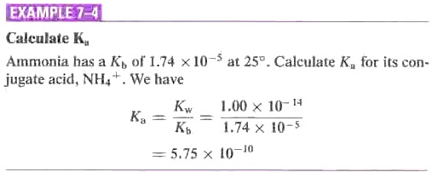
Relationship Between K_{a} and K_{b}
K_{a}= K_{w}/K_{b}
K_{b} =K_{w}/K_{a}
K_{w}. known as the autoprotolysis constant, or the ion product of water

Slide 15
Ionization of Polyprotic Electrolytes.
Acids that donate a single proton and bases that accept a single proton are called monoprotic electrolytes.
A polyprotic (polybasic) acid is one that is capable of donating two or more protons, and a polyprotic base is capable of accepting two or more protons.
A diprotic (dibasic) acid, such as carbonic acid, ionizes in two stages, and a triprotic (tribasic) acid, such as phosphoric acid, ionizes in three stages.
In any polyprotic electrolyte, the primary protolysis is greatest, and succeeding stages become less complete at any given acid concentration.
Notes:
The negative charges on the ion HPO42- make it for water to remove the proton from the phosphate ion, as reflected in the small value of Ka. Thus, phosphoric acid is weak in the third stage of ionization and a solution of this acid contains practically
noP0g- ions

Slide 16
Ionization of Polyprotic Electrolytes.
Notes:
Each of the species formed by the ionization of a polyprotic acid can also act as a base. Thus, for the phosphoric acid system
The negative charges on the ion HPO42- make it more difficult for water to remove the proton from the phosphate ion, as reflected in the small value of Ka. Thus, phosphoric acid is weak in the third stage of ionization and a solution of this acid contains practically
noP0g- ions

Slide 17
Ampholytes
Amphoteric compound
Zwitterion

Slide 18
Isoelectric point (IEP)
e.g. pH of milk 6.6 (casein IEP=4.6)
It is pH at which zwitterion concentration at maximum
It has been used for determination of protein and amino acids.
The molecules have ------------- solubility at IEP.
The net charge of a molecule at its IEP is -----------.
Charge of a molecule at pH above its IEP is ----------- and below is -----------.
Notes:
The molecules have -----minimum-------- solubility at IEP.
The net charge of a molecule at its IEP is -----Zero------.
The Charge of a molecule at pH above its IEP is -----Negative------ and below is ------Positive-----.

Slide 19
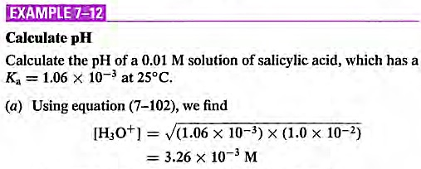
Solutions containing Strong acids
Strong acid concentration of H is equal to initial concentration of acid.
Solutions containing Only a Weak Acid
pH=2.48

Slide 20
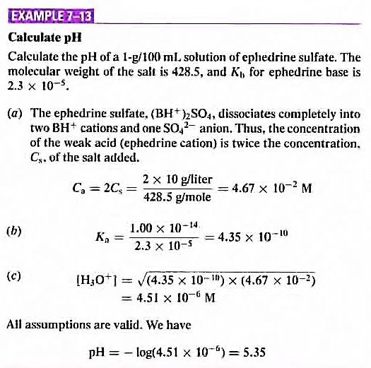

Slide 22
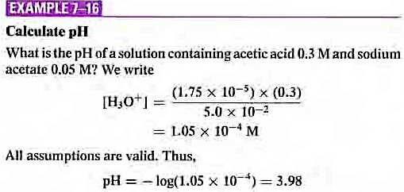
Notes:
Conjugate : Sodium acetate and acetic acid

Slide 24
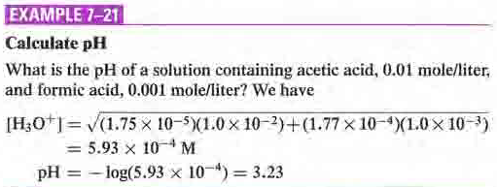

Slide 25
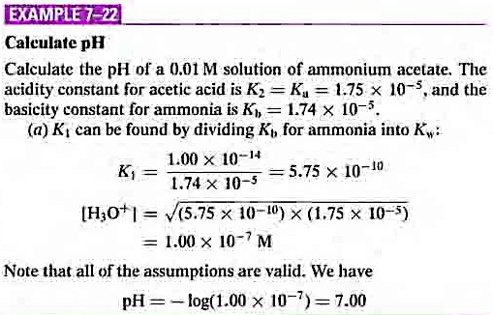

Slide 26
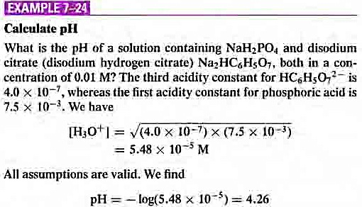
Notes:
Amino acid

Slide 27
Ionic strength

Slide 28
Ionic strength
ionic strength---I or μ ---a measure of the total ion concentration in solution----but ions with more charge are counted more due to stronger electrostatic interactions with other ions (I.e., can influence the increase “ionic atmosphere” greater than singly charged ions)

Slide 29
For zwitterion molecule
For monotropic molecule
K_{r}=Salting in constant=0.32 for amino acid in water
Notes:
(a) Convert all pK values needed for the problem into pK' values.
(b) Solve the appropriate equation in the usual manner.

Slide 30
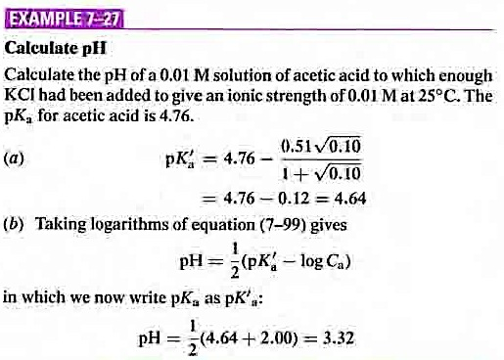
0.1

Slide 31
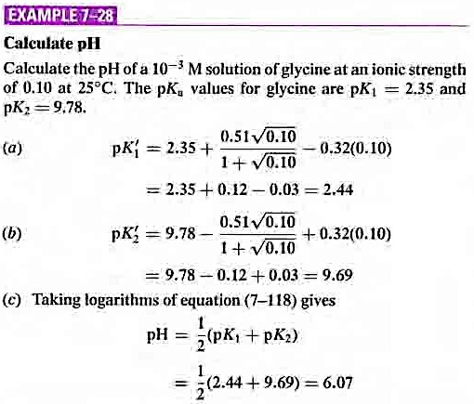

Slide 32
Thanks for your attention

